Slide 1
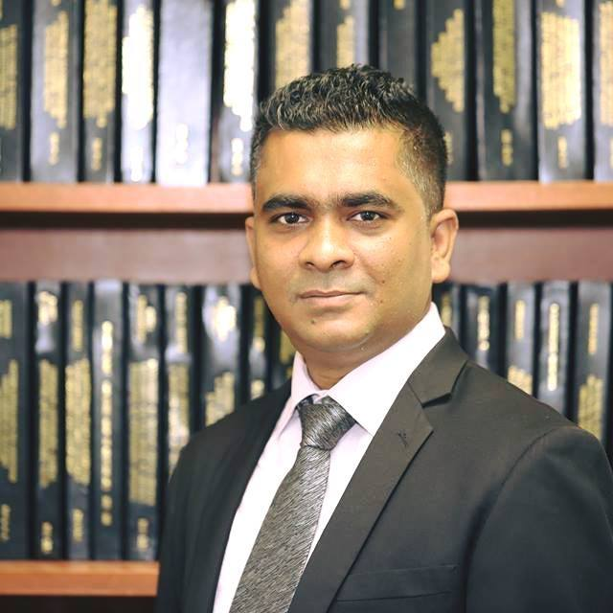

Dr. Imran Mahmud
Head &
Assistant Professor
Department of Information Technology & Management
imranmahmud@daffodilvarsity.edu.bd

Slide 2
8
4
7
2
1
3
6
9
5

Slide 3
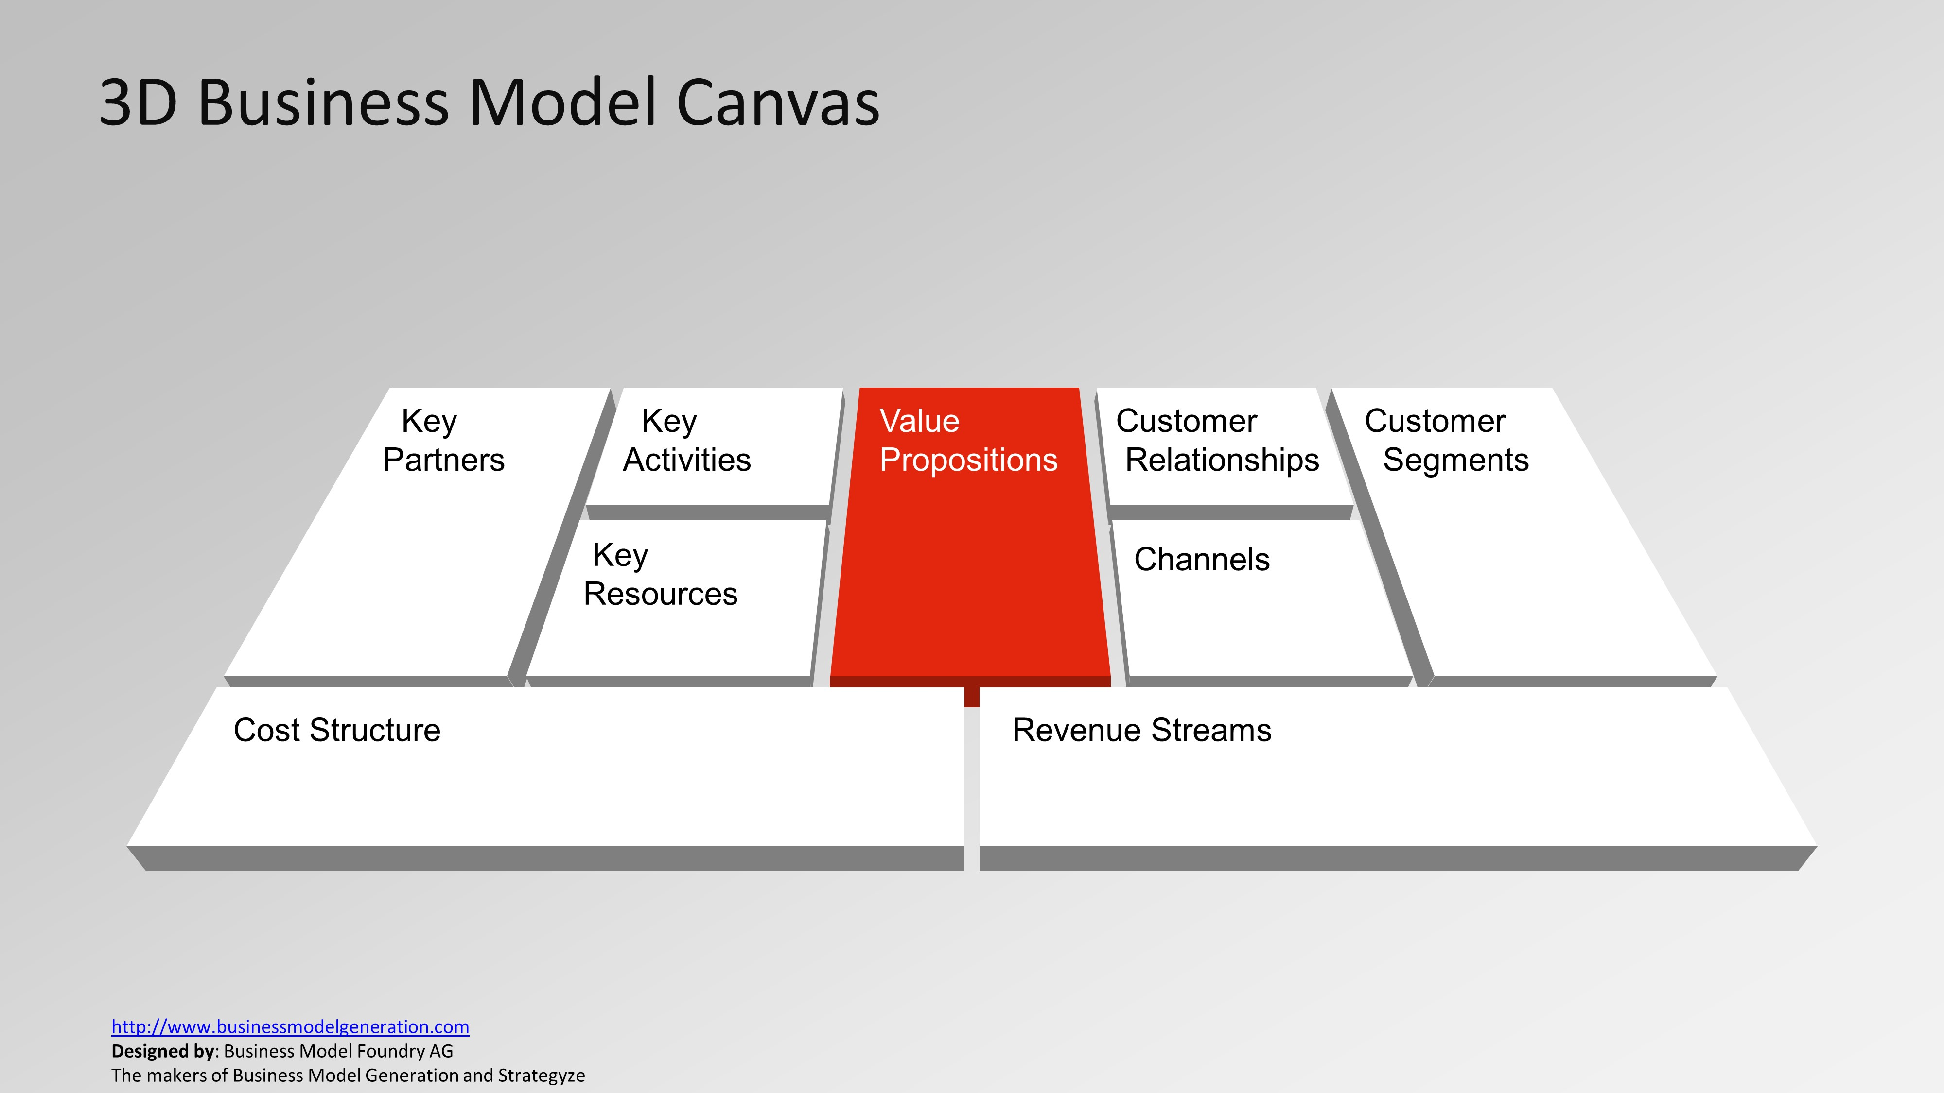
The collection of products and services that distinguishes from its competitors
GP:
Excellent Network
Customer service
DIU:
Permanent Campus
Flexible Payment Scheme
Different types of waiver

Slide 4
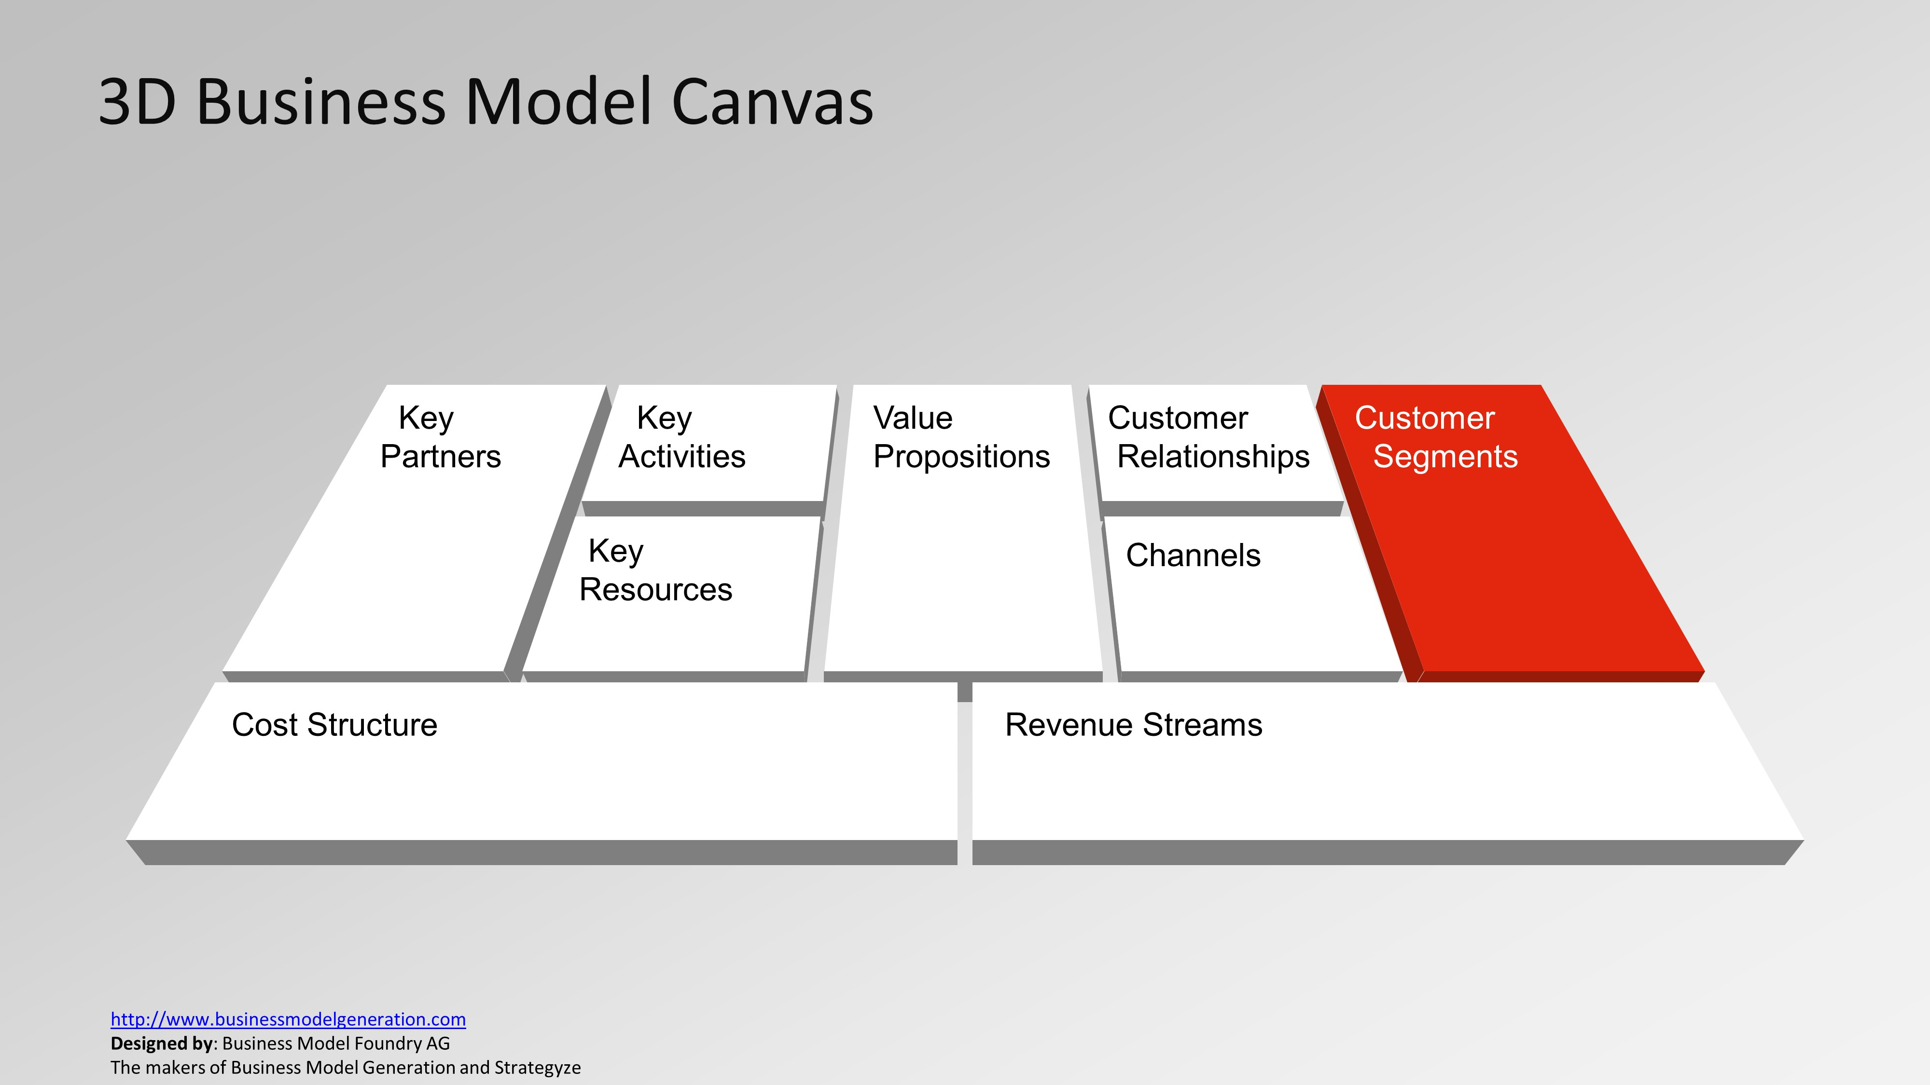
Customers' Profile
GP:
18+ citizen
Corporate offices
DIU:
HSC or Diploma pass students
Professionals

Slide 5
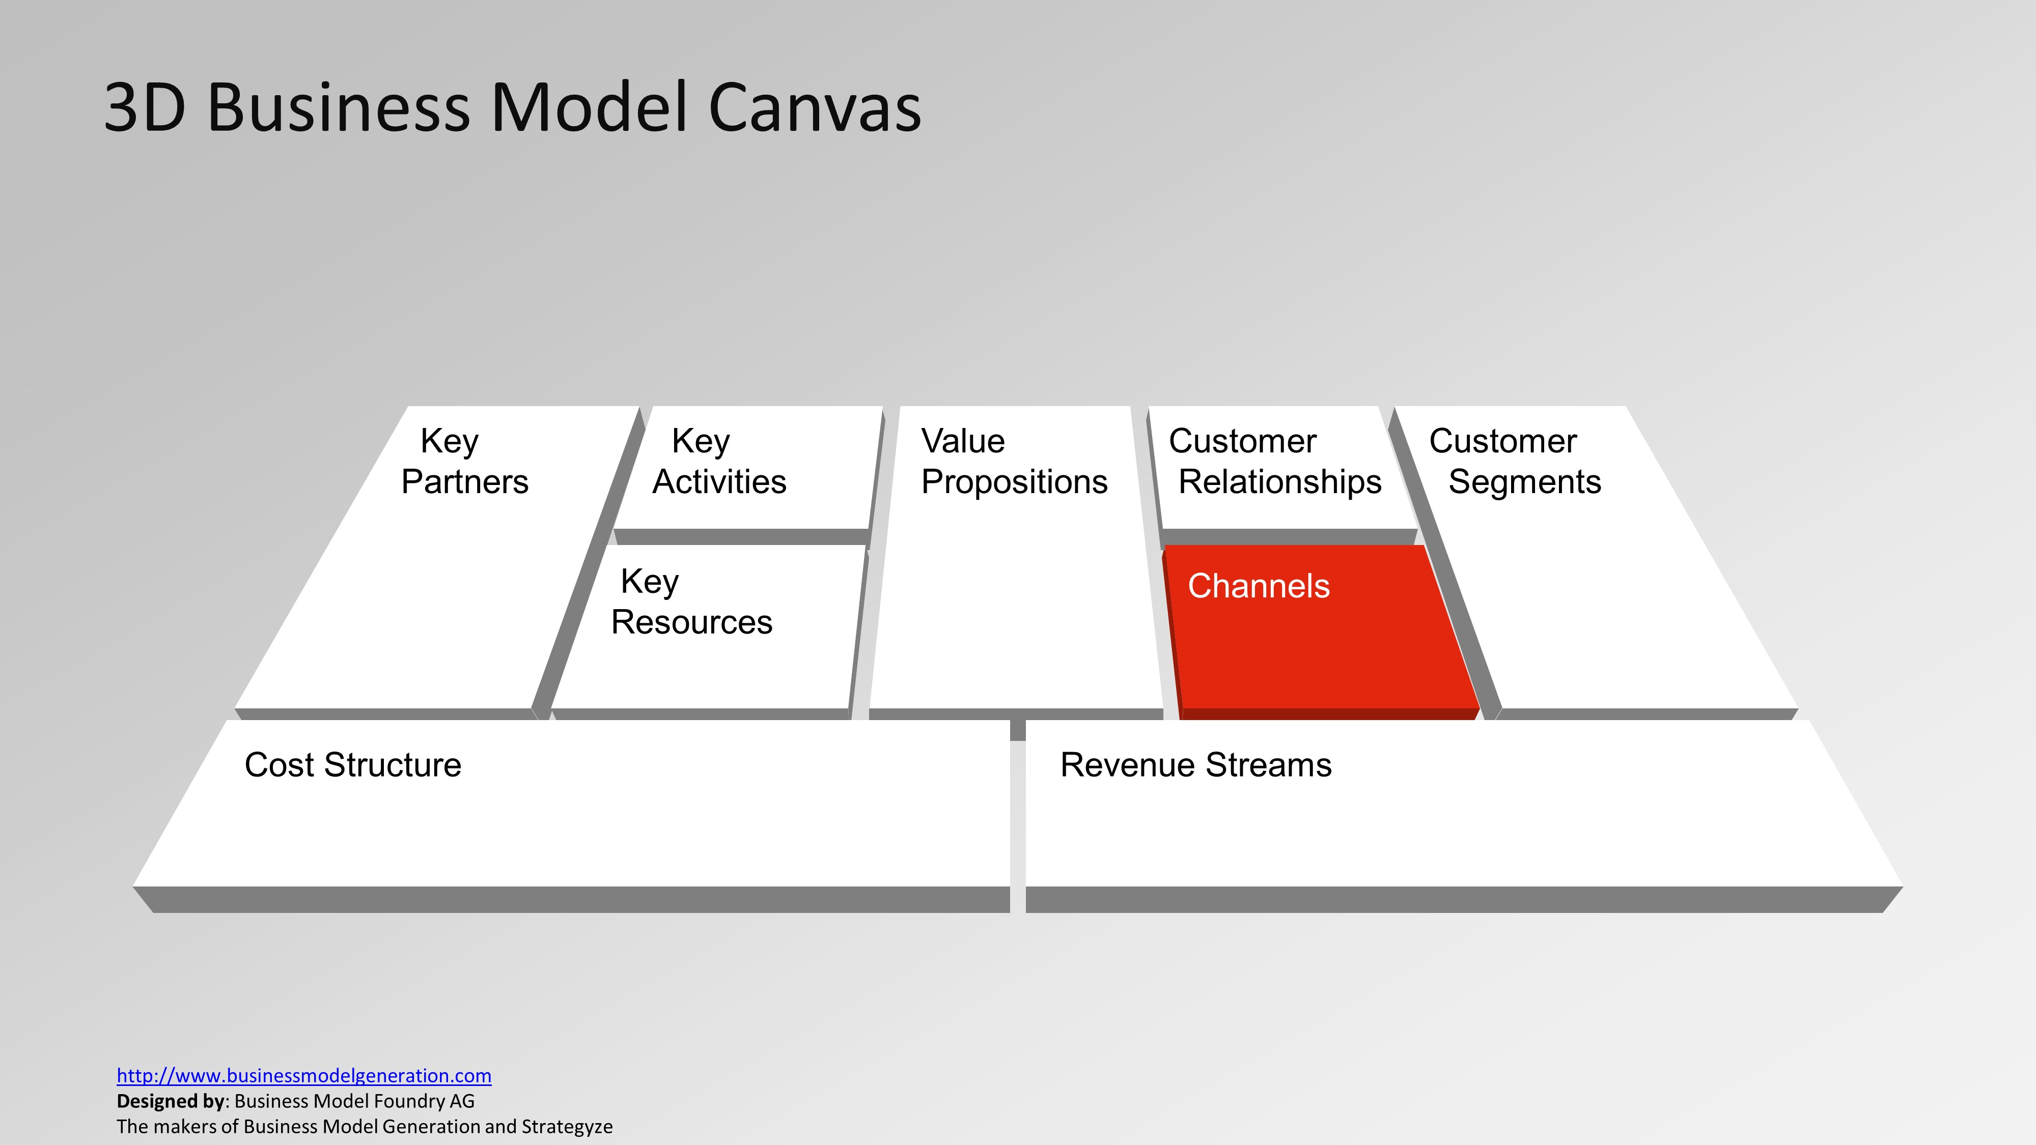
Company can deliver its value proposition to its targeted customers through different channel
GP:
Network
GP center
DIU:
Classroom
Online platform

Slide 6
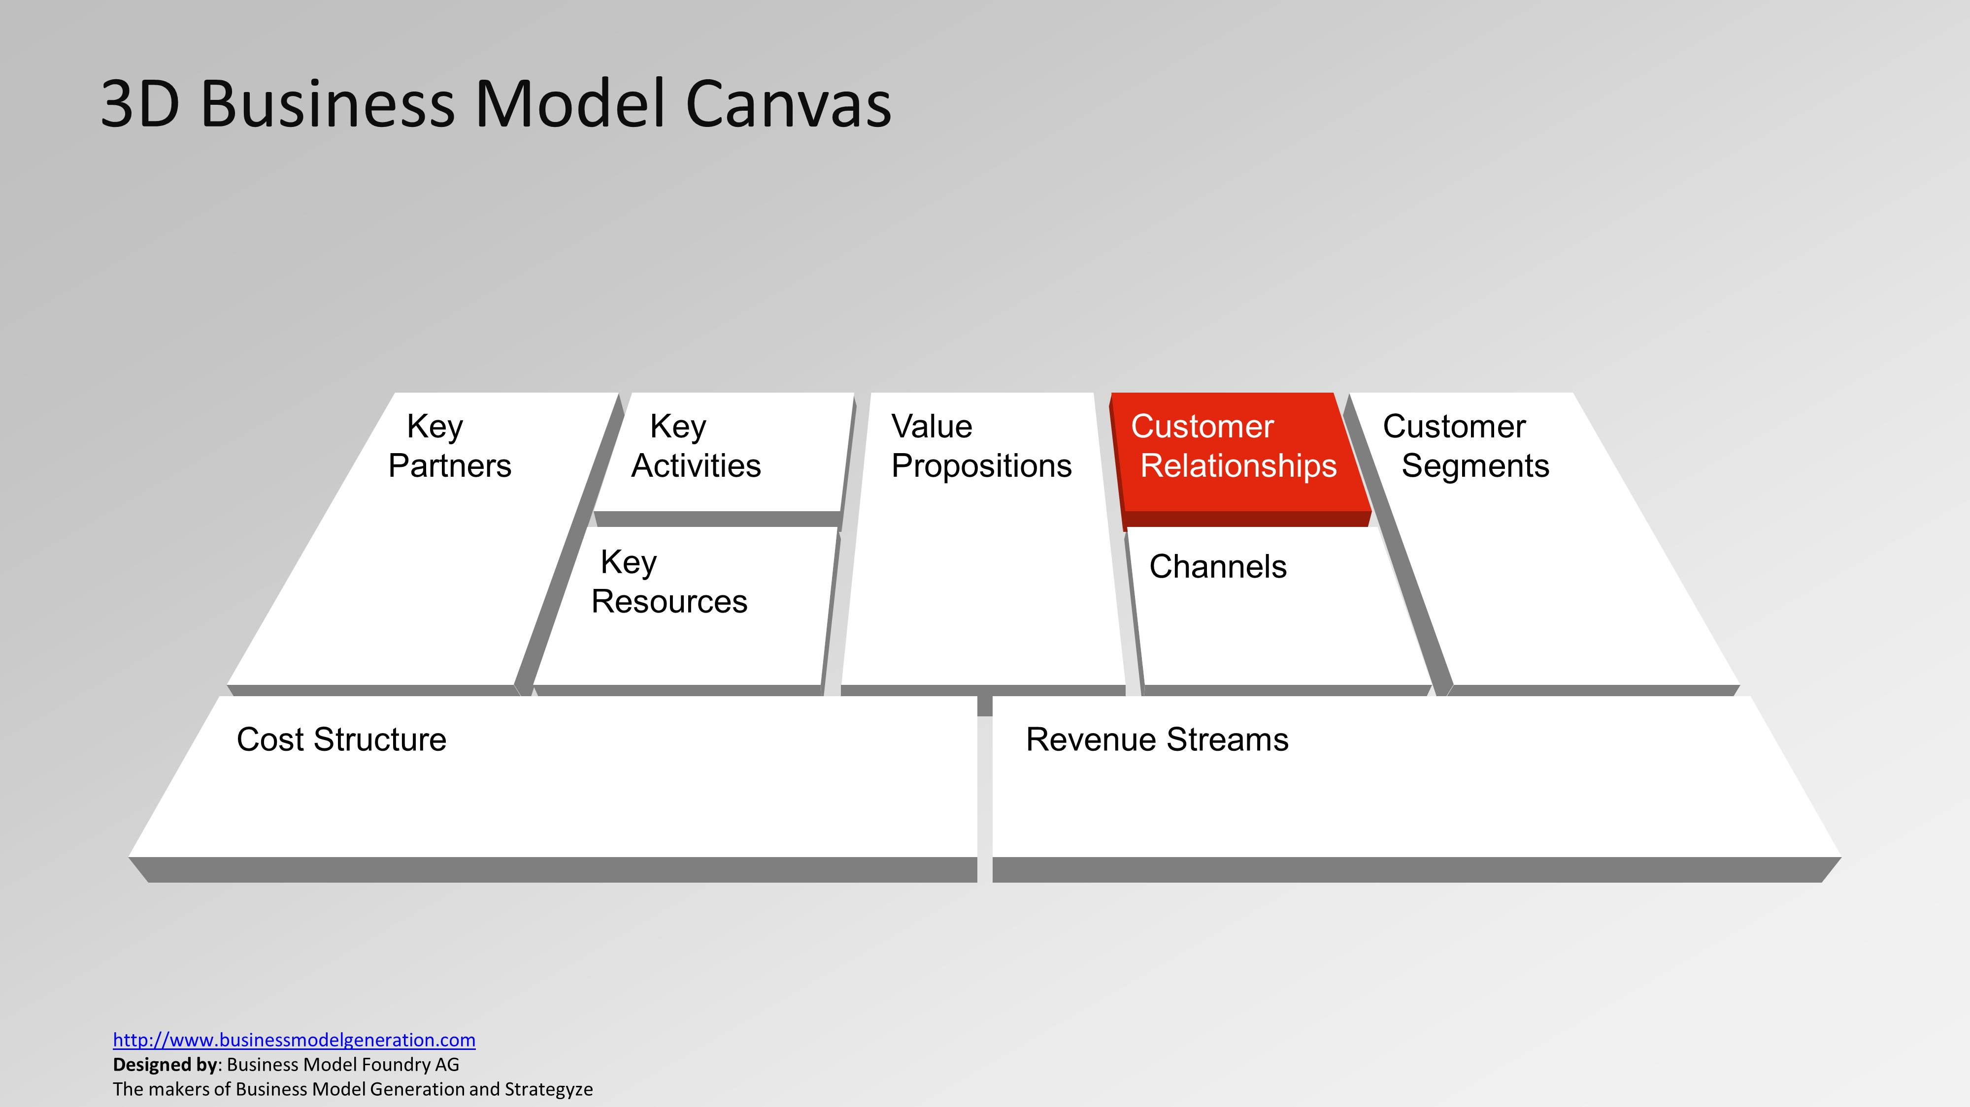
Various forms of customer relationships
GP:
Bonus offer
SMS
DIU:
Waiver
Scholarship
Student mentoring

Slide 7
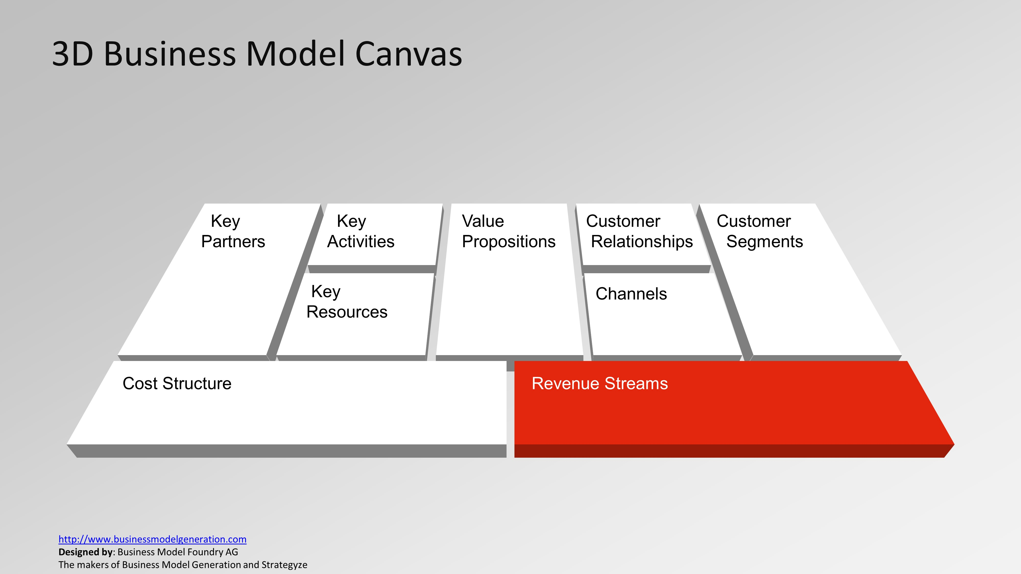
Income
GP:
Flexiload
Internet Pack
Mobile contents
DIU:
Course fee
Investment

Slide 8
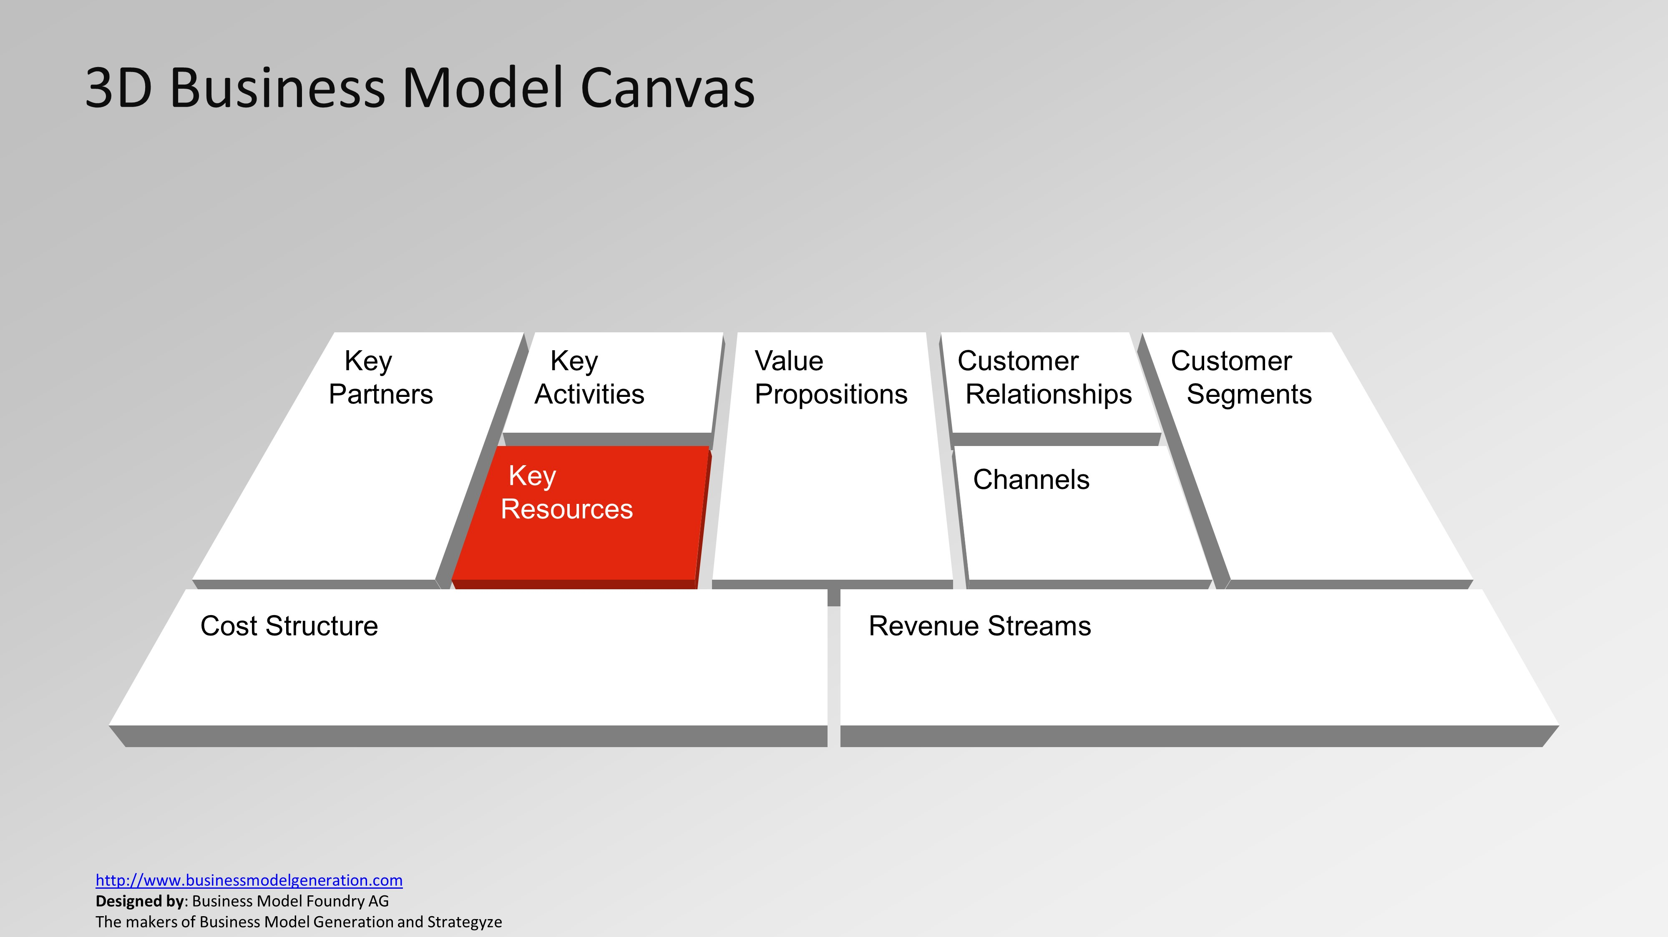
They are considered assets to a company that are needed to sustain and support the business. These resources could be human, financial, physical and intellectual.
GP:
Technological infrastructure
Skilled HR
DIU:
High qualified teachers
Skilled Administrators
Strong IT infrastructure

Slide 9
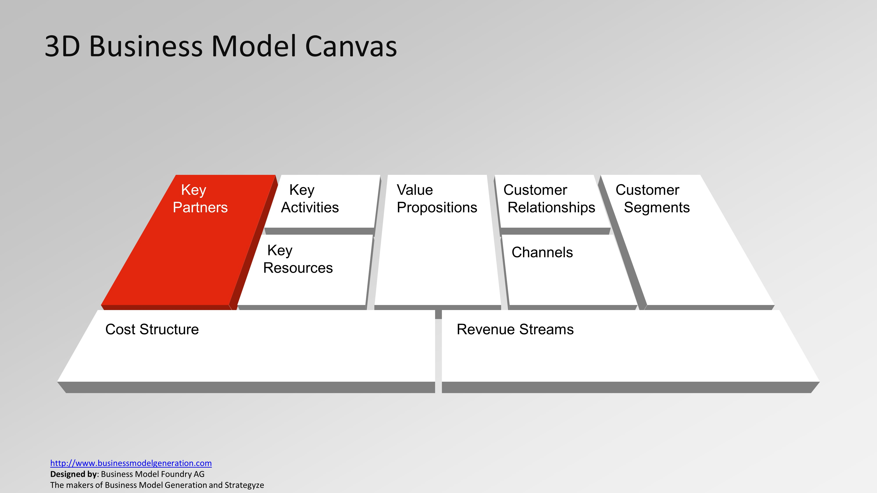
Partner network or Busienss Alliance
GP:
Multinational companies
Vendors
DIU:
Foreign Universities
Local industries

Slide 10
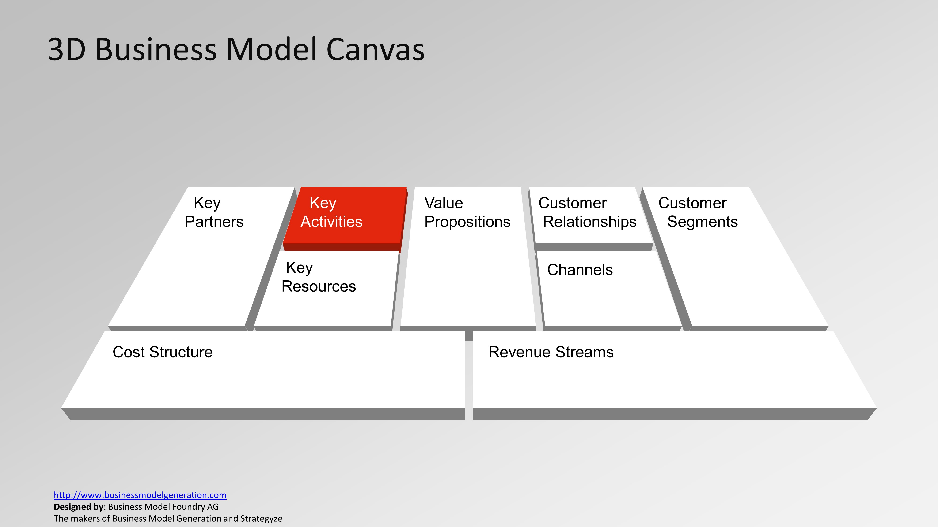
The most important activities
GP:
Call handle
Internet service
DIU:
Teaching
Research

Slide 11
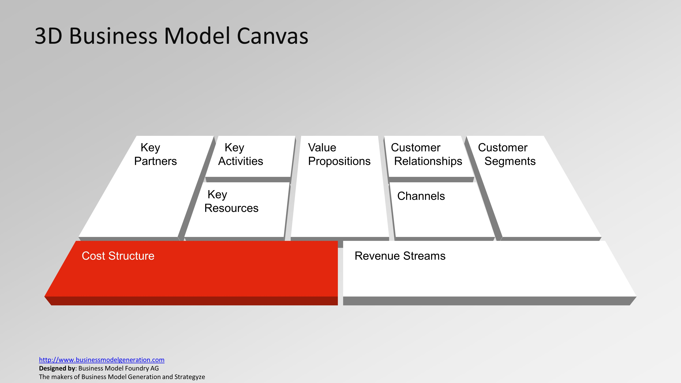
Expenses
GP:
Salary
Network improvement
Vendor cost
Govt. Tax
DIU:
Salary
Infrastucture development

Slide 12
Activities
Log in to your moodle account
Visit the course
Join the forum in the moodle for discussion
Watch the video uploaded in the moodle to gain more knowledge
Submit the assigment (Instructions are given in the moodle)

